Slide 1
This week in:
Ms. Ayah’s Class
We are learning:
Ice breaking activities
Spider web game
Hand print
Find someone who game
Classroom rules
Cereal and pasta bracelets
All about me craft
P.E day is on Monday
Kindly provide your child with healthy meals (sweets) are not allowed.
Activate your child’s Classroom Dojo account
Important Reminders
News
Week of Sep. 4th to Sep.5 th

Slide 2
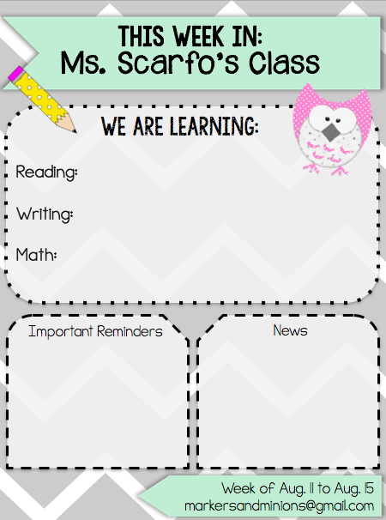
Font Guide
The fonts used in this download are KG ALL OF ME,
Janda Safe and Sound, and KG Part of Me.
You can download them for free at http://www.kimberlygeswein.com
KG ALL OF ME
Janda Safe
and Sound
KG Part of Me

